Slide 1
01
Physics project
☺

Slide 2
Our Team:
Lubomir Georgiev 9B
Eric Ivanov 9G
Stanislav Yordanov 9G
Lorena Hristova 9B
Scrum trainer and Leader
Back-End developer
Back-End developer
QA engineer

Slide 3
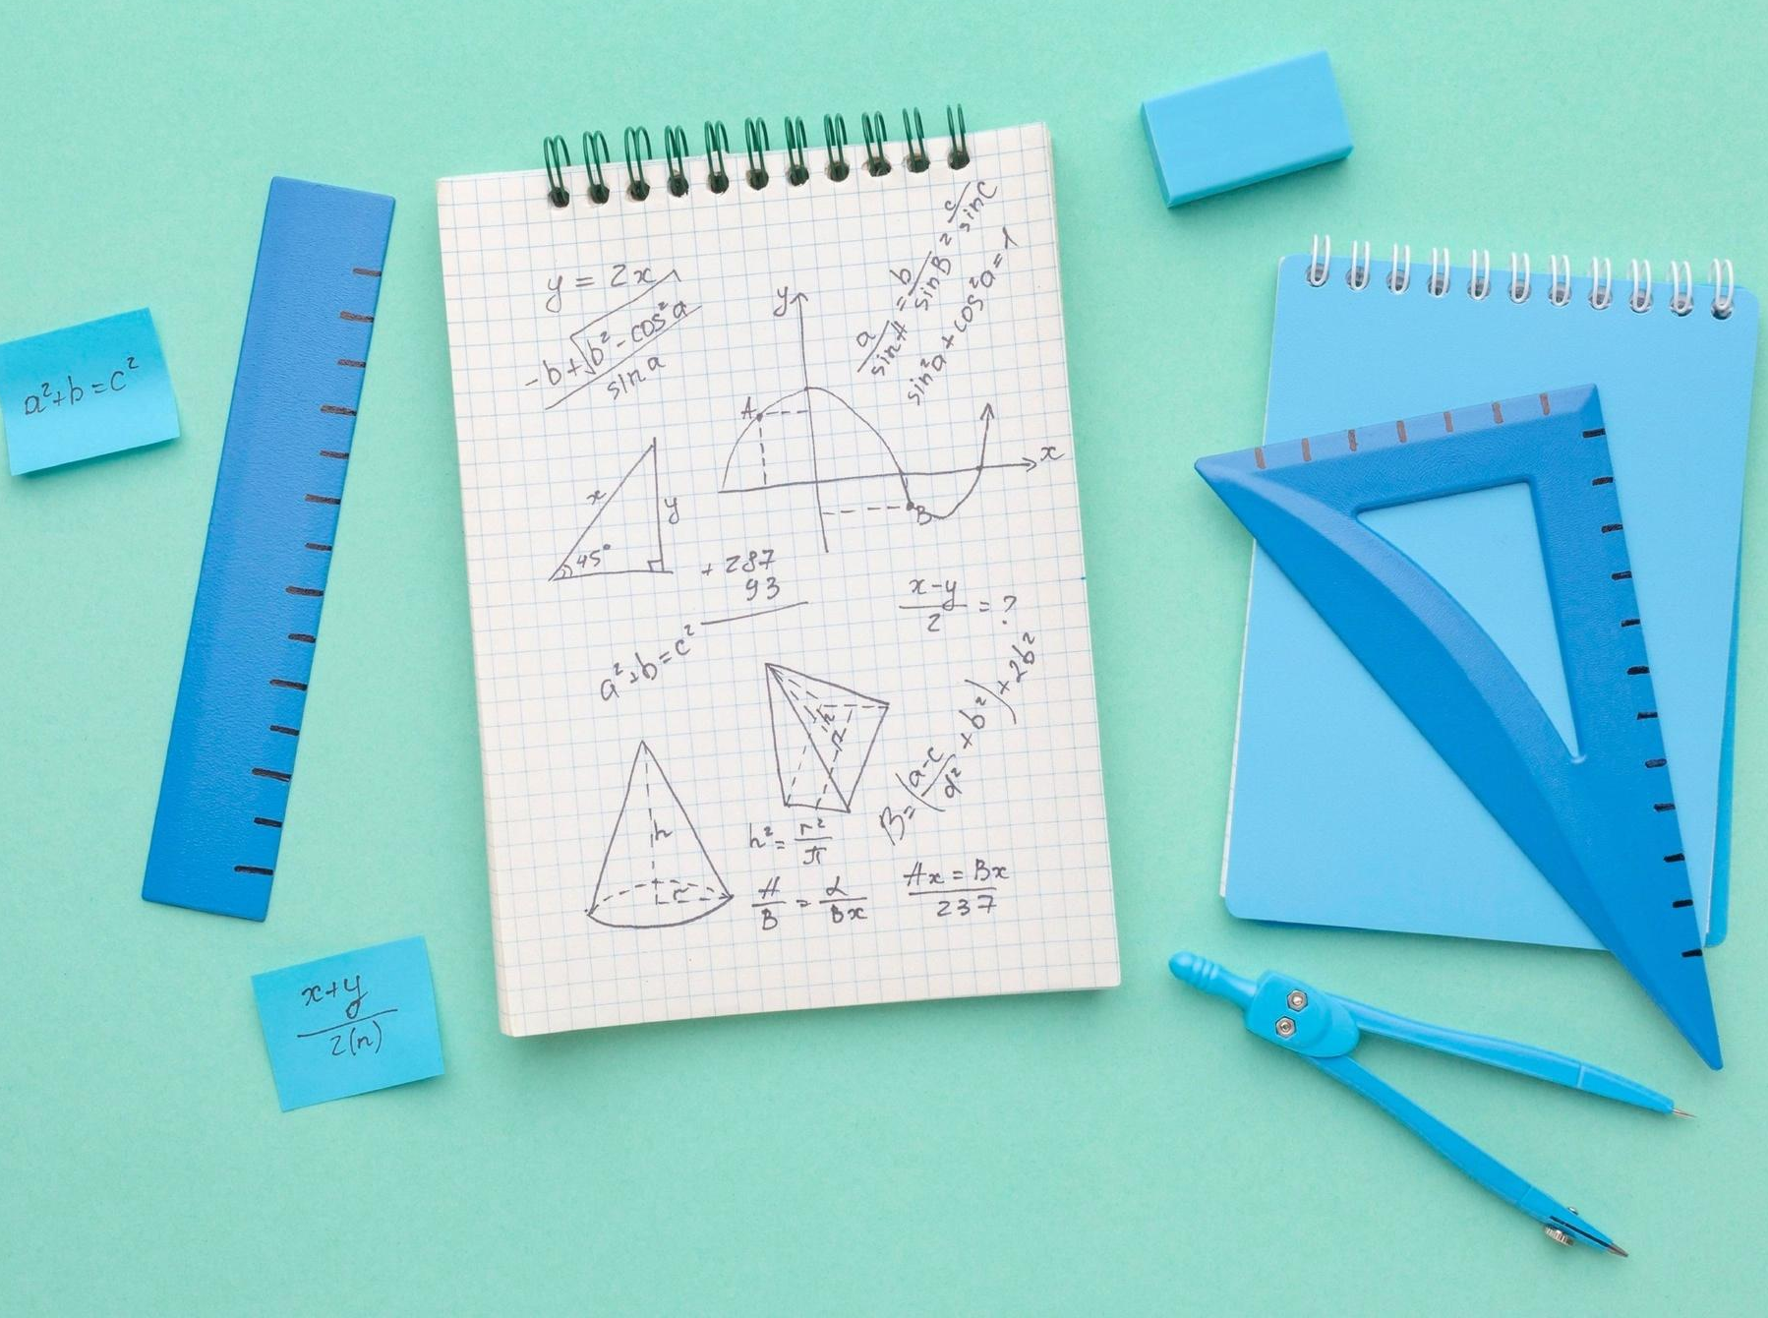


Our Idea:
Our idea is to make a calculator which convert the values ​​from one unit of physics to another.

Slide 4
Steps:
The first step was to call each other and to think about the idea
01
03
The third step was to do final touches and think what we can add
The second step was to start working
04
And the final step was the finished project
02

Slide 5






Thanks!

